Slide 1


MODULE-1 INTRODUCTION TO C++
Autonomous Institute, Affiliated to JNTUH,
Approved by AICTE, Accredited by NAAC with A++ Grade
Kacharam, Shamshabad, Hyderabad- 501 218, Telangana, India.
Topic: ACCESS SPECIFIERS
Presented By,
Mr. Ganesh Deshmukh,
Assistant Professor, CSE

Slide 2
Session outcomes
Define access specifiers and explain their role in achieving data security and encapsulation in C++ programs.
Identify and differentiate between public, private, and protected access specifiers with suitable examples.
Apply access specifiers appropriately while designing classes to control access to data members and member functions.
Demonstrate the use of access specifiers through simple C++ programs and interpret the access control behaviour during compilation and execution.

Slide 3
What are Access Specifiers?
Definition
Access specifiers define how data members and member functions of a class can be accessed from outside the class.
They are used to control data security and encapsulation.

Slide 4
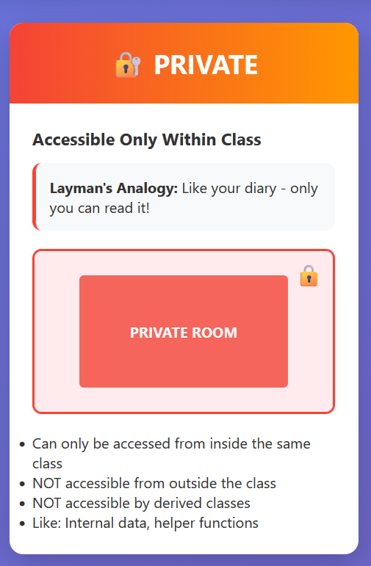
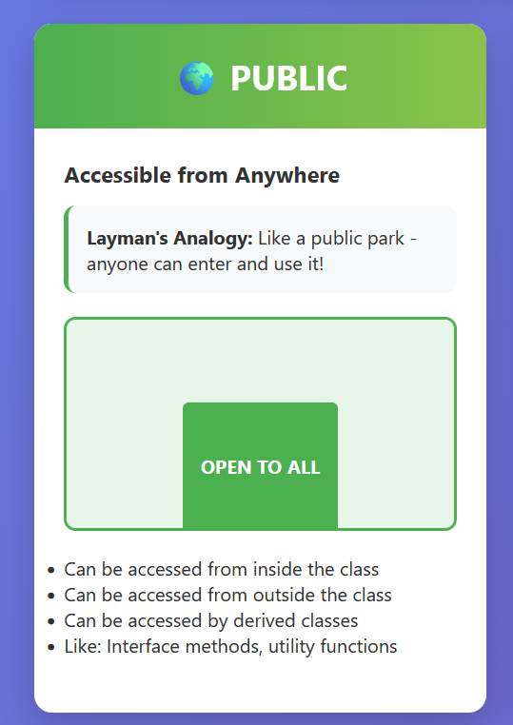
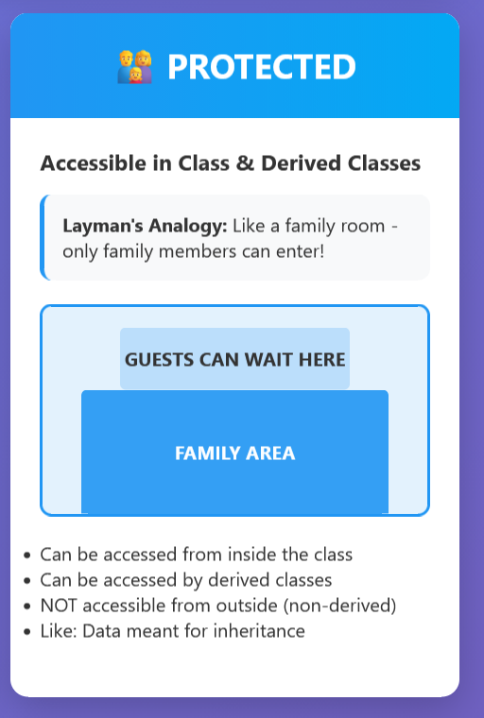
Types of Access Specifiers

Slide 5
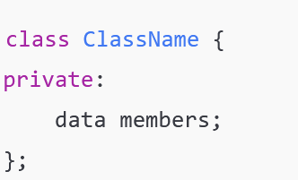
private Access Specifier
Members declared as private cannot be accessed outside the class.
Default access specifier in a class
Syntax:

Slide 6
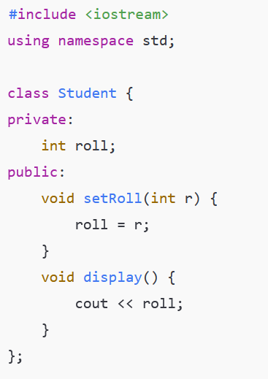
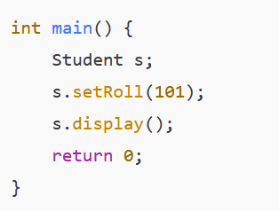
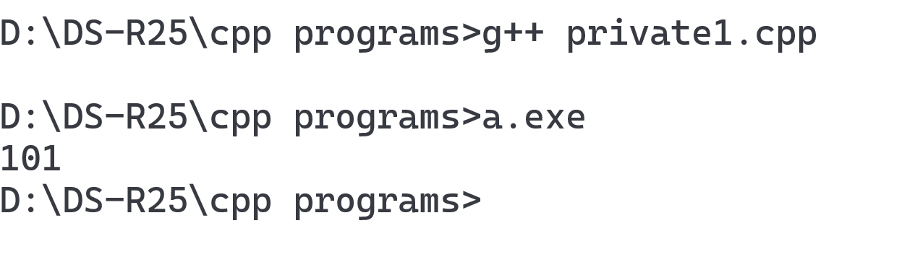
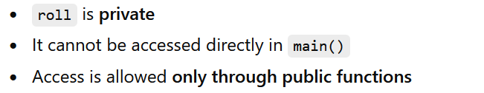
private Access Specifier
Example Program

Slide 7
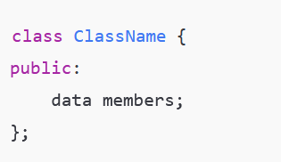
public Access Specifier
Members declared as public can be accessed from anywhere
Real-World Analogy: College notice board → Everyone can see it
Syntax:

Slide 8
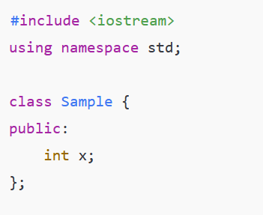
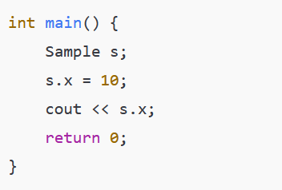
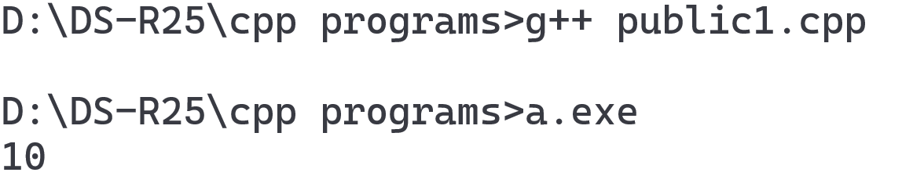
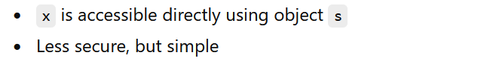
public Access Specifier
Example Program

Slide 9
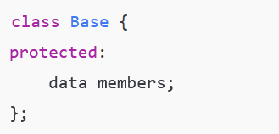
protected Access Specifier
Members declared as protected:
❌ Not accessible outside the class
✔ Accessible in derived (child) classes
Syntax:

Slide 10
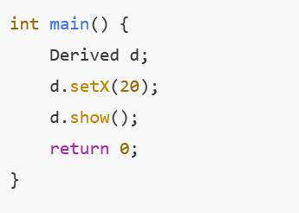
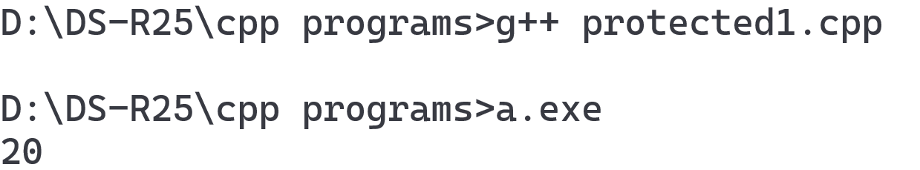
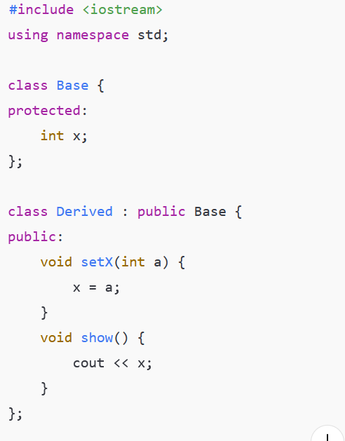
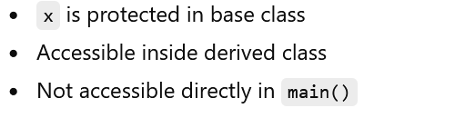
protected Access Specifier
Example Program

Slide 11
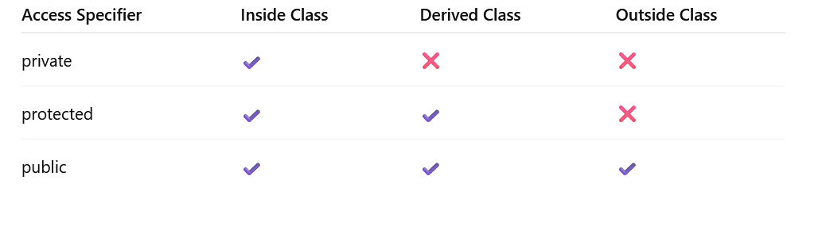
Comparison Table

Slide 12
Thank You

